Slide 1
What is being transferred in transfer learning
https://proceedings.neurips.cc/paper/2020/hash/0607f4c705595b911a4f3e7a127b44e0-Abstract.html

Slide 2
Introduction
This paper provided an analysis of what enables a successful transfer learning.
Main contribution:
1. both feature reuse and low-level statistics of the data are important.
2. Models fine tuned on target domain from pretrained weights make similar mistakes on the target source, have very similar features and very close L2 norm distance in the parameter space. Whereas Models trained on target domain from random initializations make different mistakes, have dissimilar features and farther L2 norm distance in the parameter space.
3.modules in the higher layer are more sensitive than those in the lower layer to the parameter modification.
4.one can start from early checkpoints(when enter the basin of the lose landscape) of pretrained model without losing the accuracy of the finetune model.

Slide 3
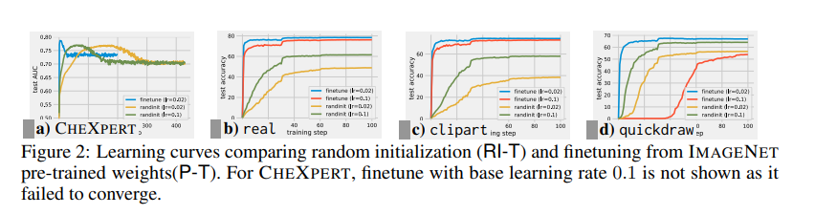
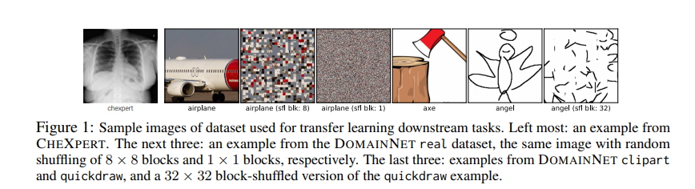
Contribution 1: the importance of feature reuse and low-level statistics
Importance of Feature reuse: From this experiment, The pretrained model is trained from the DomainNet real datasets. From the figure 2, we can see the fine-tuned model perform best on real domain, which contains many natural images and shares many similar feature with the source data DomainNet real datasets. This could confirm that feature reuse plays an important part in Transfer learning.

Slide 4
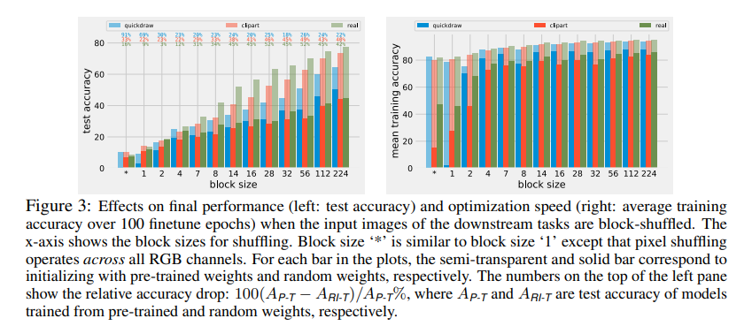
Importance of low-level statistics:
from the Figure2 showed in the last slides, we can see even for the target domain like quickdraw and chexpert, which shares no common features with the source domain, the pre trained models are also benefited from transfer learning.
In order to figure out which contribute to this, the author partition the image into small blocks to prevent the feature sharing but remain the basic low-level statistics. Figure1(the number3,4,7 image shows the effect of image shuffling), and figure3 shows the impact of block size on accuracy.
For the target domain like quickdraw, which have no common features with source domain even before the shuffling, we can see the accuracy decreased very slowly. Thus the low-level statistics are very important.

Slide 5
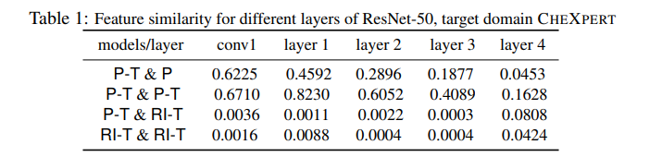
Contribution2: the difference of Investigating mistakes& Feature Similarity& Distance in parameter space between P-T and RI-T
Investigating mistakes: 1. two RI-Ts makes significant number of uncommon mistakes whereas two P-Ts make only a modicum number of uncommon mistakes. 2.RI-T is more adept to ambiguous samples whereas P-T is more adept to easy samples. This is because P-T has stronger prior, it is hard to adapt to the target domain.
Feature similarity:
The author used centered Kernel alignment(CKA) which is the latest work on estimating feature similarity. From this figure, we can see between 2P-Ts and between P-T&P, the similarity is very high, much higher than any pair containing RI-T. Also, there is an interesting find that the initialization point is so important on feature similarity.

Slide 6
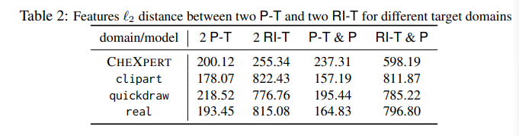
Distance in parameter space:
From Table2, we can see from whatever target domain, 2P-T and P-T&P have much smaller l2 norm distance than pairs containing RI-T.

Slide 7
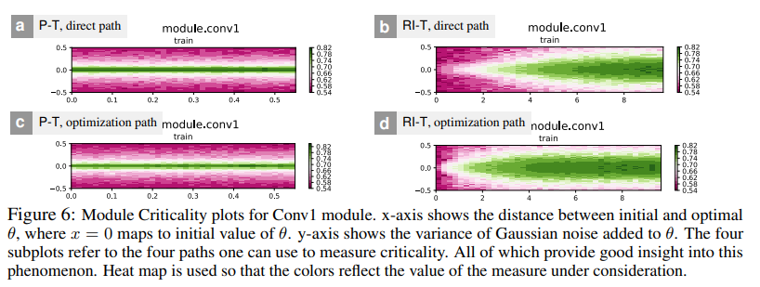
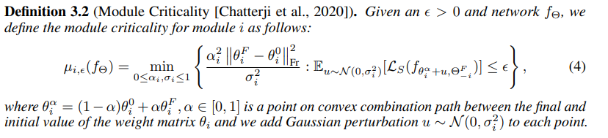
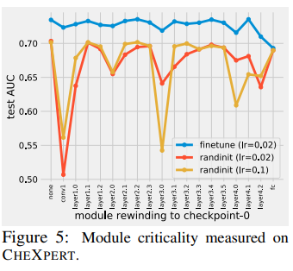
Contribution3: modules in the higher layer are more sensitive than those in the lower layer to the parameter modification.
Module criticality: consider a trained model, module criticality could be estimated by fixing the parameter of other layers and rewind the parameter of one layer into its initial value. And thus the criticality could be estimated by the Formula in Definition 3.2.
From the figure 5, we can see for P-T model, the Full connection layer is very Critical.
From the figure 6, we can see for RI-T, the adding of noise into theta could sometimes be helpful.
When the author move from input and output, they found that the module become more critical.
感想：前面举的例子感觉不能很好的论证这个神经网络越后面的layer越matter的结论。最后唯一的有力论证只是用了很小的一段话说了一下（as we move from the input towards the output, the module become more critical）感觉就是有点少了，还有最后的结论，不过也可能是我没有理解透彻。

Slide 8

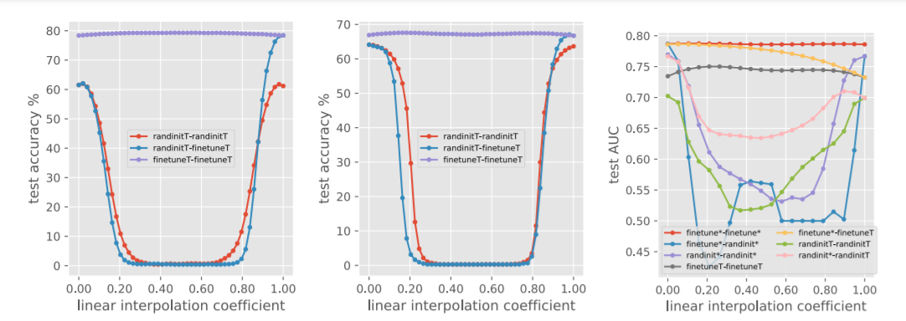
Performance barriers and basins in the landscape
In order to identify the generalization performance of different models, the author here used the linear interpolation method to identify the flatness of the basin and the potential barriers.
where and refers to all the weights from two different check points.
If the two solution and remain in the same flat basin of the loss landscape, the linear interpolation would also remain in the basin. As a result, the performance barrier is absent. However, If the two solution are random, the interpolation would have generalization performance than end points.
We can see the barrier disappeared in the P-T model(flat basin, better generalization performance) whereas exist in the RI-T model.

Slide 9
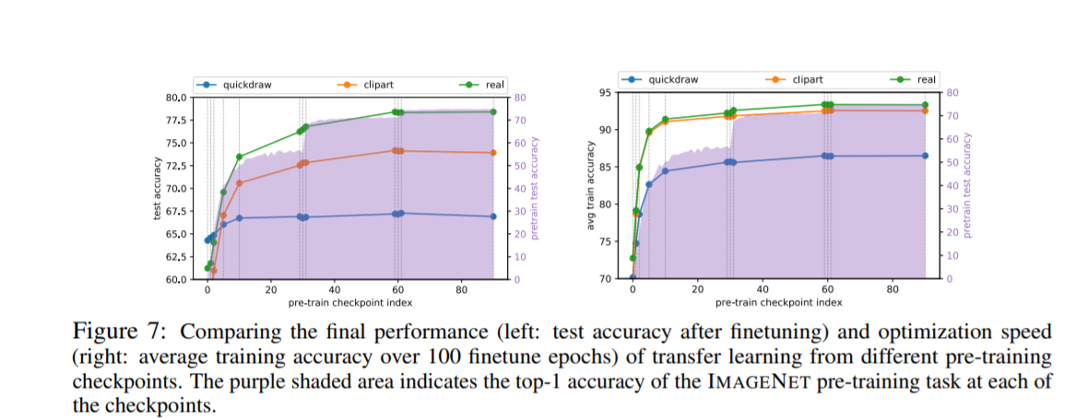
Contribution 4：one can start from early checkpoints(when enter the basin of the lose landscape) of pretrained model without losing the accuracy of the finetune model.
we can see that the final performance of each finetune model start to plateau at the early check points. Thus we can start from early checkpoints of pretrained model without losing the accuracy of the finetune model.

